Slide 1
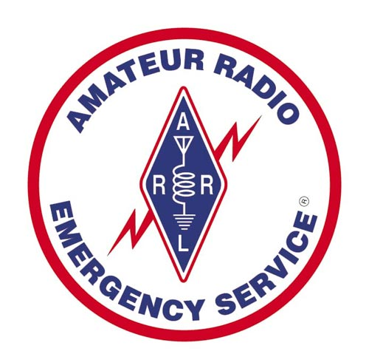
Public Service Communications
Jack Gunther
KB3KKY – Washington, DC ARES EC
Jack.gunther.dc@gmail.com
202-489-8914 (mob)

Slide 2
Agenda
Introduction to Public Service Communications
PS Communications Organizations
Incident Command System (ICS)
Nets
Traffic Handling
Emergency Support
Modes
Training/Resources

Slide 3
Introduction
Public Service Communications
Served Agencies (e.g., DC-HSEMA, Hospitals, etc.)
Public Events (Marathons, Bikeathons)
Special Events (Inauguration)
Simulated Emergency Test
Local Emergencies (Hurricanes, SKYWARN, Snow): usually coordinated locally
Remote Emergencies (Large scale disasters, Katrina, Sandy): Coordinated by Section or ARRL

Slide 4
PS Communications Orgs.
American Radio Relay League
Amateur Radio Emergency Service (ARES)
Radio Amateur Civil Emergency Service (RACES)
National Traffic System (NTS)
Radio Emergency Associated Communications Teams (REACT)
Salvation Army Team Emergency Radio Network (SATERN)

Slide 5
Incident Command System (ICS)
The Incident Command System (ICS) is a standardized, on-scene, all-hazards incident management approach that:
Allows for the integration of facilities, equipment, personnel, procedures and communications operating within a common organizational structure.
Enables a coordinated response among various jurisdictions and functional agencies, both public and private.
Establishes common processes for planning and managing resources.
Required for use as part of the National Incident Management System (NIMS)
Based upon lessons learned after major California wildfires in the 1970’s

Slide 6
ICS Features
Standardization
Common terminology
Command
Establishment and transfer of command
Chain of command and unity of command
Planning/Organizational Structure
Management by objectives
Incident Action Plan (IAP)
Modular organization
Manageable span of control
Facilities and Resources
Comprehensive resource management
Incident locations and facilities
Communications/Information Management
Integrated communications
Information and intelligence management
Professionalism
Accountability
Dispatch/Deployment

Slide 7
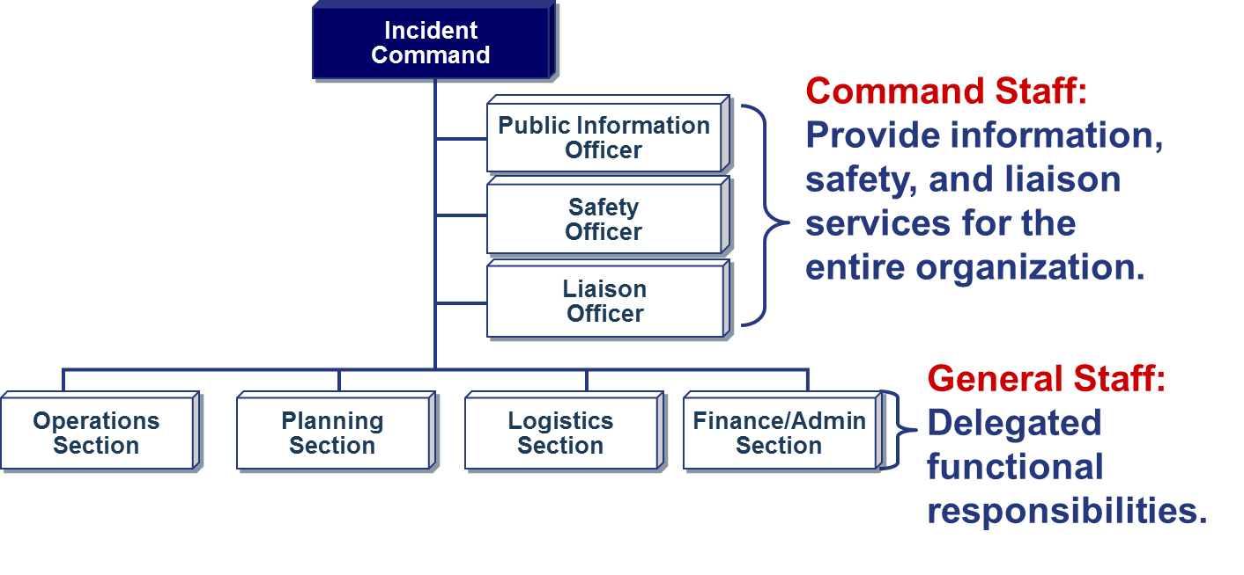
ICS Organization
Incident
Command
Operations
Section
Planning
Section
Logistics
Section
Finance/Admin
Section

Slide 8
Standard ICS Forms

Slide 9
Nets
PS Communications Nets
Open Nets
Directed Nets
NTS Nets
Types of Nets
Resource Nets
Tactical Nets
Logistics Nets
Emergency Nets
NTS Nets
ARES Training Nets

Slide 10
Nets …
Local ARES Nets
NCACNet – Sundays 9pm 146.91 MHz
Arlington County Net – Tuesdays 7:30 pm 145.47 MHz
Fairfax County Net – Wednesdays 8pm 146.79 MHz
QCWA – Sundays 9am
Vienna Wireless – Mondays (?) 146.685 MHz
MVARC Tuesdays 7pm 146.655 MHz
Montgomery County – Thursdays 8:30 (?) 146.955 MHz
Local Traffic
HF (80/40 m) 3820 kHz
Northern Virginia Traffic Net 7pm 147.300 MHz

Slide 11
National Traffic System (NTS)
The “RELAY” in American Radio Relay League (ARRL)
Started in 1915 as the formal ARRL system to relay messages around the country
Transmit & Receive Modes: Voice, CW, Digital
NTS and Amateur Radio Emergency Services (ARES)
Requirements to join: Any level Ham license & interest
ARRL Field Organization Appointments: Official Relay Station (ORS), Digital Relay Station (DRS) & Section Traffic Manager (STM).

Slide 12
NTS Hierarchy and Modes
US and Canada organized into Area, Region, and Local Nets
3 Areas
12 Regions
Traffic Flow:
TCC
Area Nets
Area Nets
HF Phone, CW, Digital
Region Nets
Region Nets
Section/ Local Nets
VHF/UHF Phone, HF Phone, CW, Digital
Section / Local Nets

Slide 13
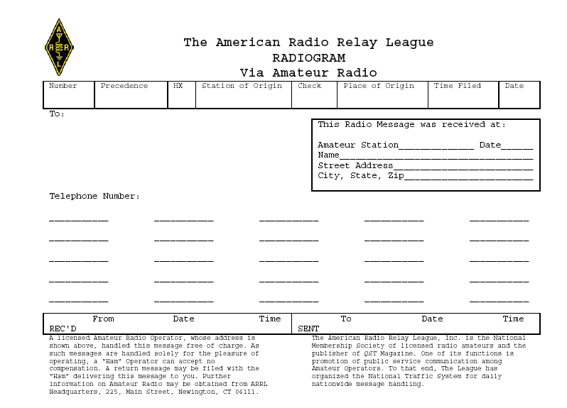
NTS Radiogram
704 R C N2GS 14 CHESTER NJ 1830 JUL 2
JOE SMITH KC2XXY 1234 SECOND ST SUMMIT NJ 07901
650-123-4567
THIS IS THE ARRL RADIOGRAM FORM XRAY DETAIL TO FOLLOW XRAY HAVE FUN 73
GREG SZPUNAR N2GS
austin AK2US 7/2/03 2112 EDT

Slide 14
ARRL Numbered Messages
ARL FORTY SIX = Greetings on your birthday and best wishes for many more to come.
ARL FORTY SEVEN = Your message ______ to ______ delivered _______ _______UTC
ARL FIFTY = Greetings by amateur radio.
ARL FIFTY ONE = Greetings by amateur radio. This message is sent as a free public service by ham radio operators at _______. Am having a wonderful time.
ARL SIXTY SEVEN = Your message number _____ undeliverable because of ______. Please advise.

Slide 15
Emergency Support
As a rule we don’t ‘Self-Deploy’
Called out by DC HSEMA for incidents
Hurricane Irene (Red Cross)
Hurricane Irene (HSEMA)
Sandy (HSEMA)
Sandy (EOM – Disaster Assessments)
Next Up – Presidential Inauguration
Usually operate on VHF or UHF Repeaters
Some events use 6m or NVIS 80m

Slide 16
Modes
HF – Long-Haul using 40/80m NVIS or otherwise; voice, cw, digital
VHF – Primarily local and via gateways; voice, digital
UHF – Primarily local and via gateways; voice, digital
Winlink 2000 – HF/VHF email using a sound card in you computer as a digital modem.

Slide 17
Advantages of modes
A. Voice net Useful for short, real-time, tactical messages, not attractive for long lists of materials (e.g., a large supply list) or for sensitive information. Acronyms can be tedious to send, lots of “I Spell…”
B. CW net Advantage is that you get a positive character-by-character copy of messages. More secure than voice because not as many people can copy code. Can be tedious for long lists of materials (e.g., large supply listing). Acronyms are sent positively as code.
C. Packet More secure than voice or cw. Can send longer messages more effectively than voice or cw. Not very effective for immediate passing of information to a large number of stations. No requirement for an NCS
D. Non-Packet Digital More secure than voice or cw. Require an NCS; can send images as fax in some cases, good for longer lists, maps, directions
E. Winlink 2000 More secure than voice or cw. Send/Receive email over the radio (HF or VHF). Originally developed for use at sea.

Slide 18
Training/Resources
ARRL EMCOMM Courses
Level 1 – Basic to Advanced EMCOMM
Level 2 – EMCOMM for managers
ARRL Website
PS Communications Manual
NTS Resources
ARES Resources
FEMA
Training.Fema.org – ICS and related training
National Interoperability Field Operations Guide (NIFOG)

Slide 19
Local Training
DC HSEMA Training Site:
https://trainingtrack.hsema.dc.gov/Home.aspx
Capitol Region NIMS Courses
http://www.ncr-nims-officers.eventbrite.com/
Texas A&M Engineering Extension Service
http://www.teex.org/index.cfm

Slide 20
Next Steps
Amateur License
LICENSING CLASS
02/26/2013 | Alexandria VA 22314
Start/End Dates: 02/26/2013 - 05/07/2013
Times: 1900 - 2130
# of Sessions: 9
Class level: Technician
Come Join Us!

